Slide 1
Input Output Organization

Slide 2
Peripheral Devices
The Input / output organization of computer depends upon the size of computer and the peripherals connected to it. The I/O Subsystem of the computer, provides an efficient mode of communication between the central system and the outside environment.
The most common input output devices are:
Monitor
Keyboard
Mouse
Printer
Magnetic tapes

Slide 3
Input - Output Interface
Input Output Interface provides a method for transferring information between internal storage and external I/O devices.
Peripherals connected to a computer need special communication links for interfacing them with the central processing unit.
The purpose of communication link is to resolve the differences that exist between the central computer and each peripheral.

Slide 4
The Major Differences are:-
Peripherals are electro-mechnical and electromagnetic devices and CPU and memory are electronic devices. Therefore, a conversion of signal values may be needed.
The data transfer rate of peripherals is usually slower than the transfer rate of CPU and consequently, a synchronization mechanism may be needed.
Data codes and formats in the peripherals differ from the word format in the CPU and memory.
The operating modes of peripherals are different from each other and must be controlled so as not to disturb the operation of other peripherals connected to the CPU.

Slide 5
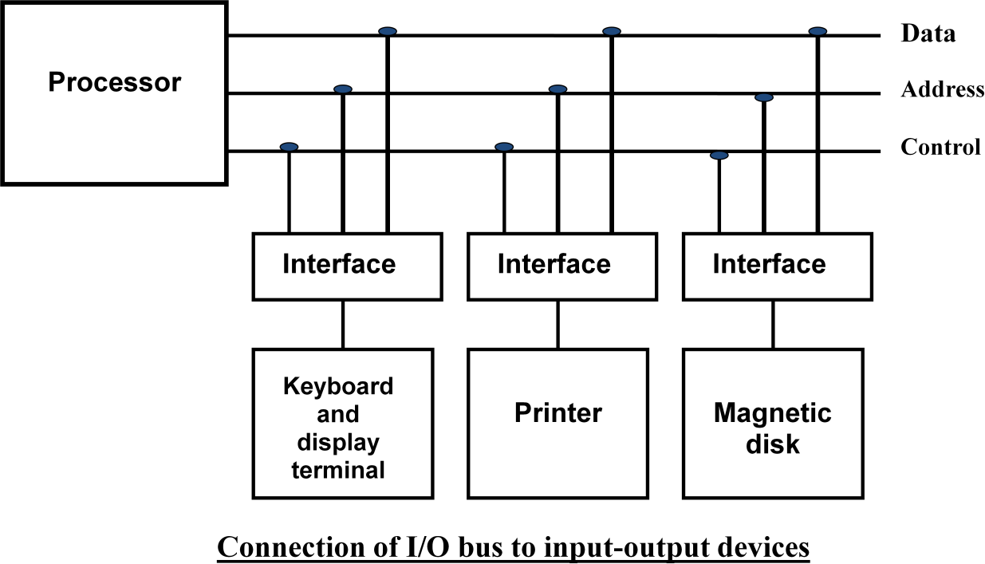
I/O Interface
To Resolve these differences, computer systems include special hardware components between the CPU and Peripherals to supervises and synchronizes all input and out transfers. These components are called Interface Units because they interface between the processor bus and the peripheral devices.

Slide 6
I/O Commands
Control Commands
Status Commands
Data Output Commands
Data Input Commands

Slide 7
I/O BUS and Interface Module
To communicate with I/O, the processor must communicate with the memory unit. Like the I/O bus, the memory bus contains data, address and read/write control lines. There are 3 ways that computer buses can be used to communicate with memory and I/O:
1. Use two Separate buses , one for memory and other for I/O.
2. Use one common bus for both memory and I/O but separate control lines for each.
3. Use one common bus for memory and I/O with common control lines.
I/O Processor: In the first method, the computer has independent sets of data, address and control buses one for accessing memory and other for I/O. This is done in computers that provides a separate I/O processor (IOP). The purpose of IOP is to provide an independent pathway for the transfer of information between external device and internal memory.

Slide 8
Modes of Data Transfer
Transfer of data is required between CPU and peripherals or memory or sometimes between any two devices or units of your computer system. This data transfer with the computer is called Internal Operation.
The data transfer can be handled by various modes. some of the modes use CPU as an intermediate path, others transfer the data directly to and from the memory unit and this can be handled by 3 following ways:
Programmed I/O
Interrupt-Initiated I/O
Direct Memory Access (DMA)

Slide 9
Programmed I/O Mode
In this mode of data transfer the operations are the results in I/O instructions which is a part of computer program. Each data transfer is initiated by a instruction in the program. Normally the transfer is from a CPU register to peripheral device or vice-versa.
Once the data is initiated the CPU starts monitoring the interface to see when next transfer can made. The instructions of the program keep close tabs on everything that takes place in the interface unit and the I/O devices.

Slide 10
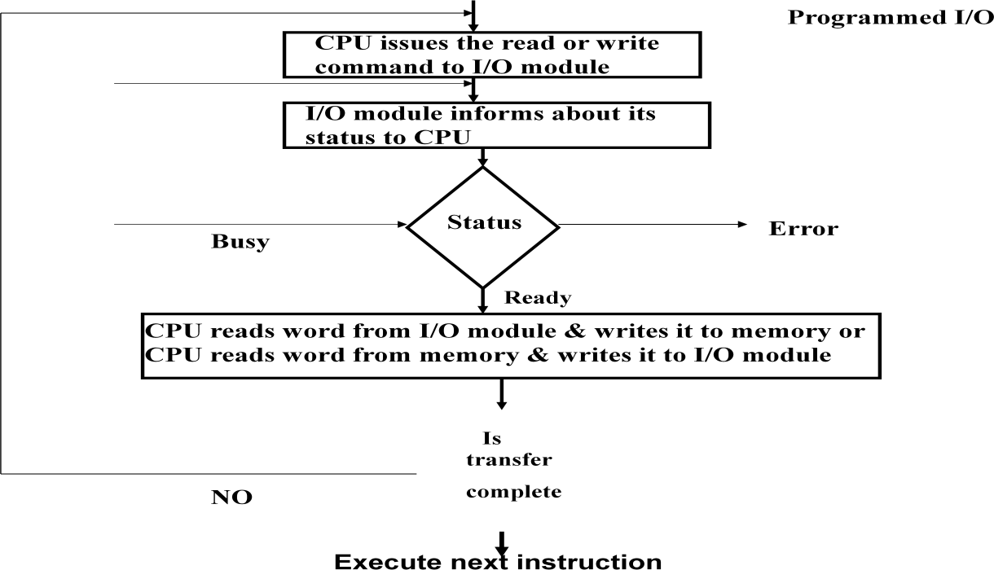
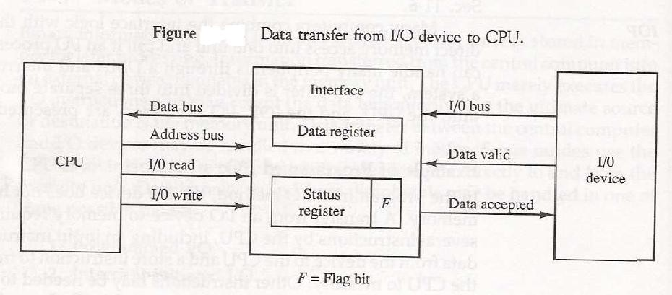
Programmed I/O Mode

Slide 11
Drawback of the Programmed I/O
The main drawback of the Program Initiated I/O was that the CPU has to monitor the units all the times when the program is executing. Thus the CPU stays in a program loop until the I/O unit indicates that it is ready for data transfer. This is a time consuming process and the CPU time is wasted a lot in keeping an eye to the executing of program.
To remove this problem an Interrupt facility and special commands are used.

Slide 12
Interrupt-Initiated I/O
In Interrupt initiated IO, CPU does not check the flag. It continue to perform its task. Whenever any device wants the attention, it sends the interrupt signal to the CPU. CPU then deviates from what it was doing, store the return address from PC and branch to the address of the subroutine.
In this method an interrupt command is used to inform the device about the start and end of transfer. In the meantime the CPU executes other program. When the interface determines that the device is ready for data transfer it generates an Interrupt Request and sends it to the computer.
There are two ways of choosing the branch address:
Vectored Interrupt: In vectored interrupt the source that interrupt the CPU provides the branch information. This information is called interrupt vectored.
Non-vectored Interrupt: In non-vectored interrupt, the branch address is assigned to the fixed address in the memory.

Slide 13
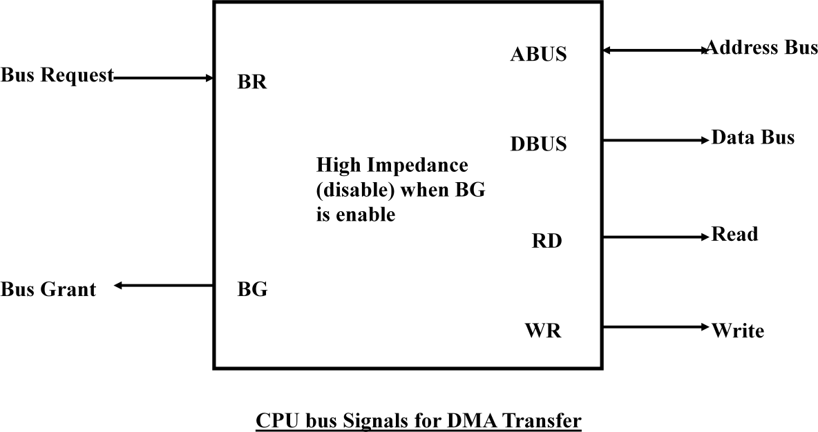
Direct Memory Access (DMA)
Removing the CPU from the path and letting the peripheral device manage the memory buses directly would improve the speed of transfer. This transfer technique is called Direct Memory Access (DMA). During the DMA transfer, the CPU is idle and has no control of the memory buses. A DMA Controller takes over the buses to manage the transfer directly between the I/O device and memory.

Slide 14
These two control signals in the CPU that facilitates the DMA transfer:
The Bus Request (BR) input is used by the DMA controller to request the CPU. When this input is active, the CPU terminates the execution of the current instruction and places the address bus, data bus and read write lines into a high Impedance state. High Impedance state means that the output is disconnected.
The CPU activates the Bus Grant (BG) output to inform the external DMA that the Bus Request (BR) can now take control of the buses to conduct memory transfer without processor.

Slide 15
The transfer can be made in several ways that are:
DMA Burst
Cycle Stealing
DMA Burst :- In DMA Burst transfer, a block sequence consisting of a number of memory words is transferred in continuous burst while the DMA controller is master of the memory buses.
Cycle Stealing :- Cycle stealing allows the DMA controller to transfer one data word at a time, after which it must returns control of the buses to the CPU.

Slide 16
DMA Controller
The DMA controller needs the usual circuits of an interface to communicate with the CPU and I/O device. The DMA controller has three registers:
Address Register :- Address Register contains an address to specify the desired location in memory.
Word Count Register :- WC holds the number of words to be transferred. The register is incre/decre by one after each word transfer and internally tested for zero.
Control Register :- Control Register specifies the mode of transfer

Slide 17
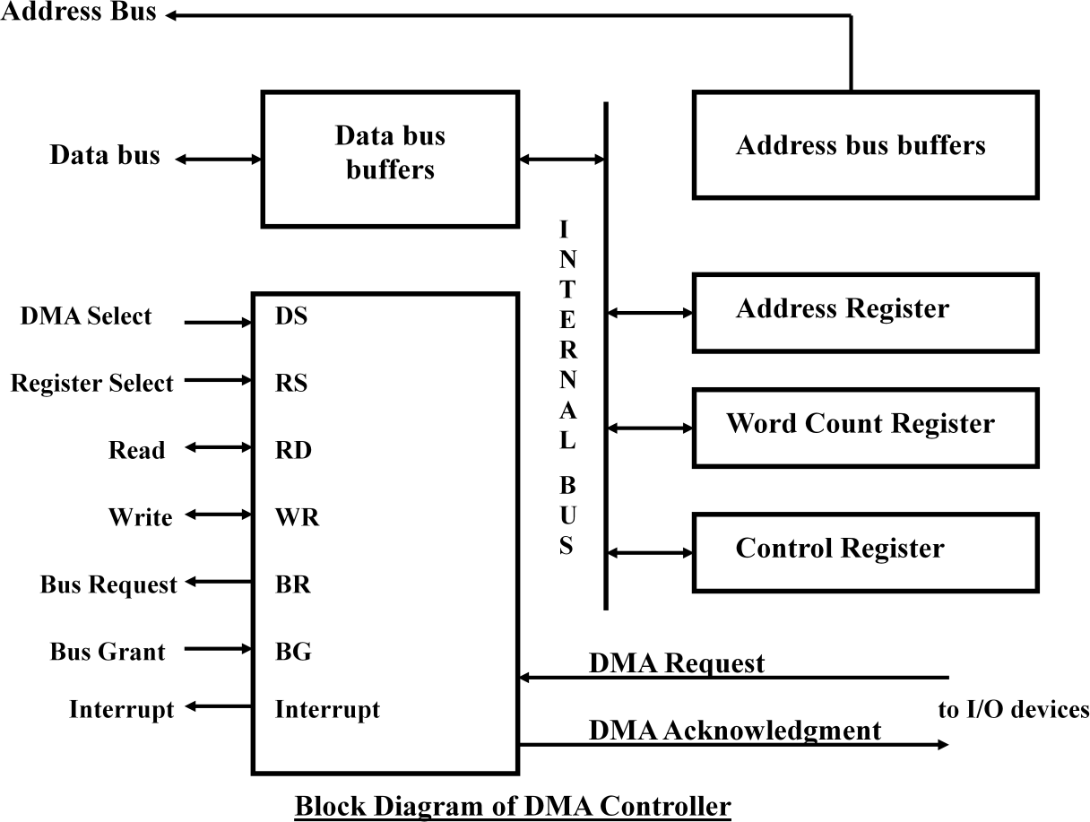

Slide 18
The unit communicates with the CPU via the data bus and control lines. The registers in the DMA are selected by the CPU through the address bus by enabling the DS (DMA select) and RS (Register select) inputs. The RD (read) and WR (write) inputs are bidirectional.
When the BG (Bus Grant) input is 0, the CPU can communicate with the DMA registers through the data bus to read from or write to the DMA registers. When BG =1, the DMA can communicate directly with the memory by specifying an address in the address bus and activating the RD or WR control.

Slide 19
Summary
Interface is the point where a connection is made between two different parts of a system.
Programmed I/O mode of data transfer the operations are the results in I/O instructions which is a part of computer program.
In the Interrupt Initiated I/O method an interrupt facility an interrupt command is used to inform the device about the start and end of transfer.
In the Direct Memory Access (DMA) the interface transfer the data into and out of the memory unit through the memory bus.

Slide 20
Input-Output & Interrupts
Types of Interrupts:
External Interrupt
Internal Interrupt
Software Interrupt

